Slide 1
Digital Immersion Course
DXC Onboarding App Design

Slide 2
Agenda
Training
DTC Problem Statement
Project Sprints
Demo
Databases
Final Thoughts

Slide 3
Training
To improve process flows and aim to reduce waste

Slide 4
Scrum.org
    Transparency - Everyone understands each other's work
    Inspection – Constant evaluation of progress towards sprint goal
    Adaptation – To minimalize deviation from goal
Kanban
    Lean – Flexible rules (WIP) – Constantly evolving
    Board – Visualise - To do – Doing – Done – Blockers
    Open Jobs – It's your choice!

Slide 5
DTC Problem Statement
Digital Immersion Project

Slide 6
Choice of Projects
    Wearable Tech - For partnered charity to improve the quality of life various individuals.
    Supply & Demand RPA – To automate the supply and demand of roles and resources in DTC
    Onboarding App– To update the current outdated process of onboarding to an app

Slide 7
Improving Onboarding
    We chose the onboarding project due to our own fresh experience with the process
    Factors against the autism project included:
  Lack of experience with wearable technology
  Very open definition of brief
    Factors against the RPA project included:
  A better initial understanding of app design then automation
  Personal interests were lower
  Our personal experiences of the onboarding process can be summarized as follows:
  Multiple separate IT systems for different tasks confusing
  Slow process for reimbursement of expenses
  Unclear when systems were available for use
  Easy to lose track of tasks and requirements

Slide 8
Features and Functionality
Here is an overview of the features the team wanted to implement to help improve the onboarding process, and the technical functionality required for these.
Feature | Functionality
Input personal details (Address, NI number, DoB etc.) | Input fields for text, number Date picker Address autofill
Upload important proofs and documents | Upload button Camera access
E-sign of employee contract | Access to view and sign contract
Set up payroll banking information | Multiple card input and selection
Reimburse assessment day expenses | Input fields for text, number Card selection Receipt upload
DXC systems explanations (MyDXC, workday, Concur etc.) | Button to external website Longer sections of text

Slide 9
Project Sprints
The Onboarding App

Slide 10
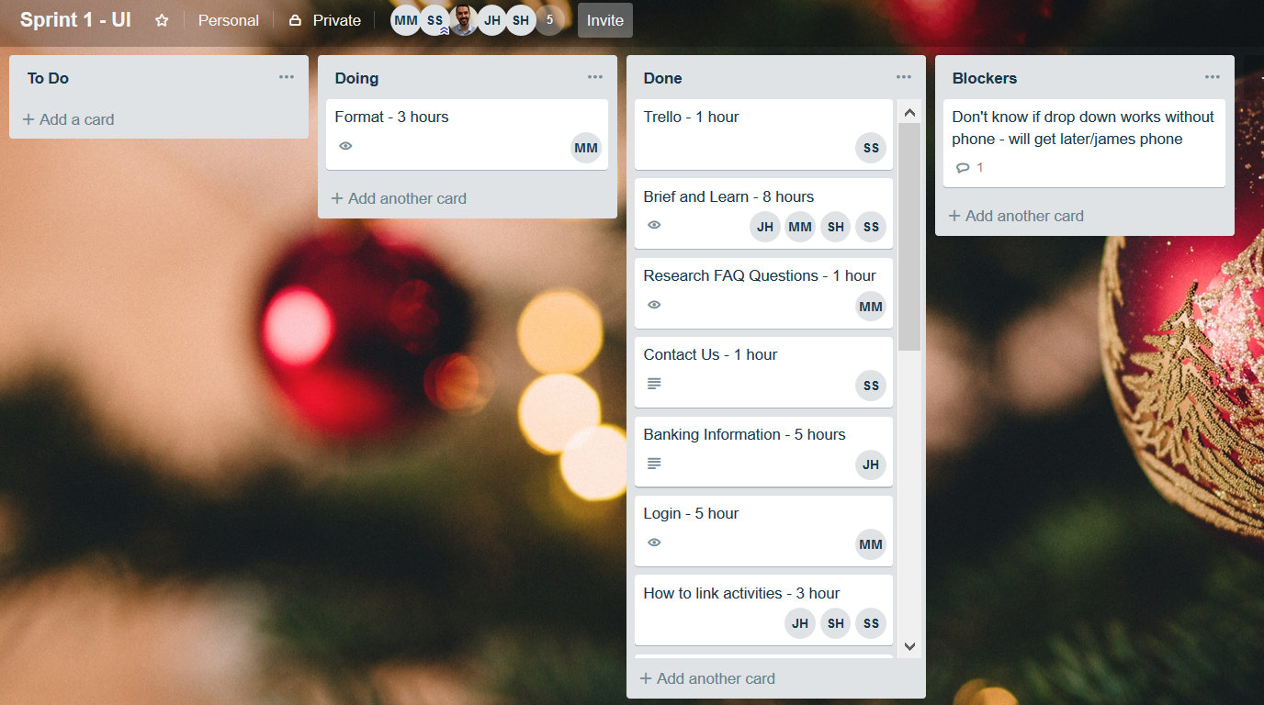
Sprint 1
    Planned to implement the front-end slides and user interface.
    Using Visual Studio and android studio we each built pages needed for out functionality.
    Quickly changed from visual studio to android studio because of ease of use.
    Outlined expected duration in each task.
    By the end of the sprint we had completed all tasks apart from formatting uniformly and we had minimal blockers.

Slide 11
Sprint 1 - Blockers
    Android Studio or Visual Studio?
    Emulators
    Unknown times of completion
    In-app items behave differently in design to in emulated app

Slide 12
Sprint 1 - Review
    Beginning using only Android Studio
    Visual Studio over Android Studio for iOS?
    Time taken for each task
    Decide on format before

Slide 13
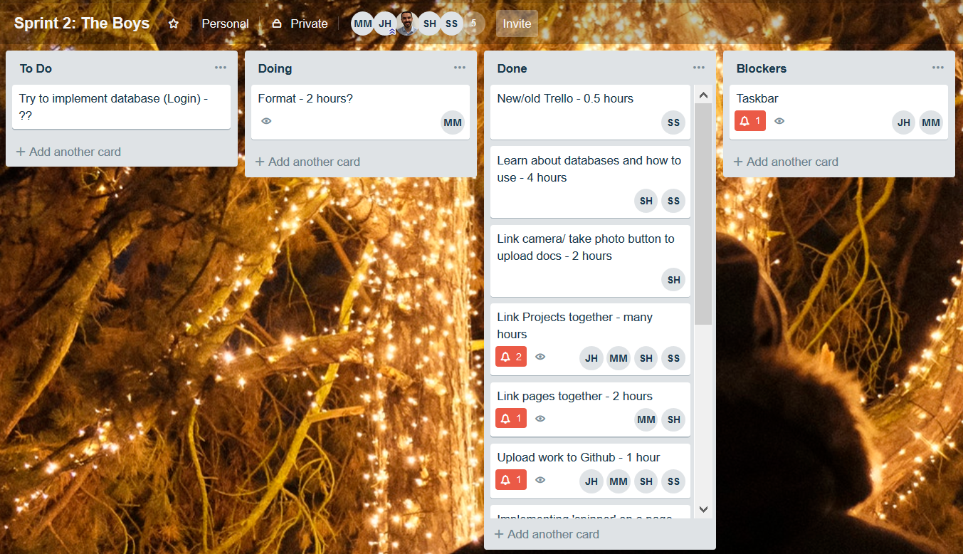
Sprint 2
    Discovering GitHub and successfully sharing our individual tasks
    Adding functionality such as buttons to link pages, access external information camera access
    Linking pages together
    Learning about databases

Slide 14
Sprint 2 - Blockers
    GitHub
    Creating uniform taskbar
    Formatting

Slide 15
Sprint 2 - Review
    Having a better understanding of GitHub to begin with
    Linking pages took much longer than planned

Slide 16
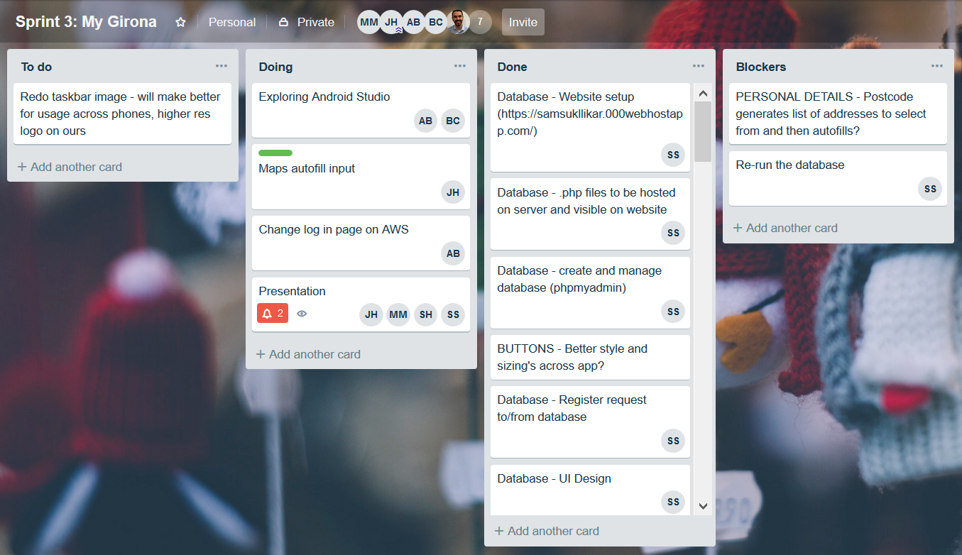
Sprint 3
    Research and create databases to save information of graduates
    Adding helpful not vital features
    Bug fixing
    Improving app format and feel

Slide 17
Sprint 3 - Blockers
    Databases took much longer than expected because of knowledge gap and learning
    Tried to implement an address look up but understanding and timescales didn't fit project

Slide 18
Sprint 3 - Review
    Team learning of the databases would have helped with understanding and blockers
    Updating and merging on one laptop hinders progress. Better understanding of GitHub would solve this.

Slide 19
App Demo
Digital Immersion Project

Slide 20
Databases
Digital Immersion Project

Slide 21
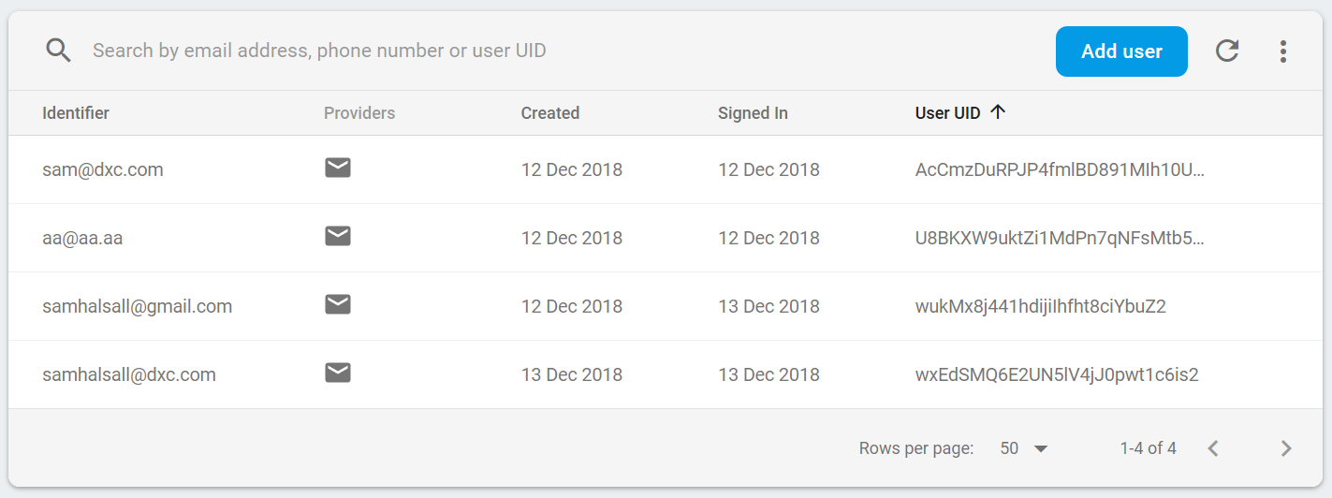
Database: Firebase
Struggled to build internal database on Android Studio
Firebase is Google's platform for developing high-quality apps and implementing database
Uses simple email/password authentication integrated with app login page
Advantages: easy to use and understand, reliable, can register new users through Firebase, provides platform to upload documents, doesn't impact UI of app login page

Slide 22



Database – Amazon Web Services
Amazon Cognito
Creates User Accounts
Provides a Sign in / Sign Up UI
Used for authentication for other services
Scalable
Amazon DynamoDB
Used for storing user information
Integrates with Cognito
Scalable
Amazon S3
Used for storing user files
Integrates with Cognito
Scalable

Slide 23
Final Thoughts
Digital Immersion Project

Slide 24
Further Improvement Areas
The following areas have been identified as areas we’d continue work on over following sprints if carrying on with this project.
    Fully working and integrated databases
    Look at how databases could be integrated with DXC systems
    Better visual formatting further in line with DXC’s branding requirements
    Bring external systems across multiple websites into the app for ease of use
    Implementing more difficult features
  Address autofill from a postcode
  Document storage in databases
  Map view within the app

Slide 25
Opinions On The Course
    It took until the second sprint to begin making serious progress
    Work done within a sprint can be completed significantly faster in following sprints
    Would be interesting if there was a way for DXC to continue work on same project
    Interesting, interactive learning style better than “classroom” teaching
    Appreciated free working environment with no external pressure from a client
    Independence developed working on own blockers
    Good to network with different areas of the building and DXC when solving blockers
    Working with other grads was helpful, we're all at the same learning stage therefore it was a safe environment where we could learn together and mistakes weren't an issue

Slide 26
Graduates – Digitally Immersed

